Slide 1
Chapter 6 (Part B)
Entity Relationship (ER) Modelling
Tenary Relationship

Slide 2
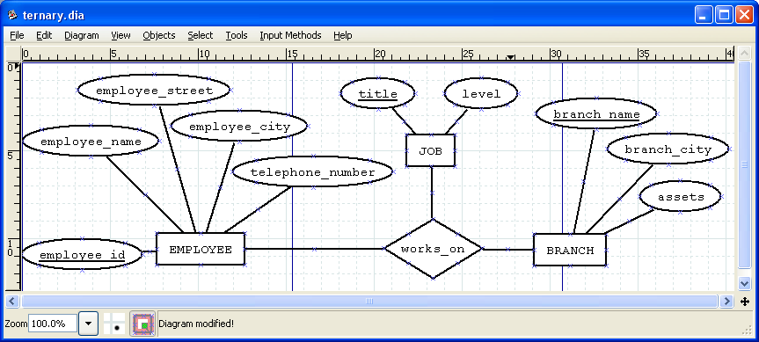
E-R Diagram with a Ternary Relationship

Slide 3

Cardinality Constraints on Ternary Relationship
We allow at most one arrow out of a ternary (or greater degree) relationship to indicate a cardinality constraint
E.g. an arrow from works_on to job indicates each employee works on at most one job at any branch.

Slide 4
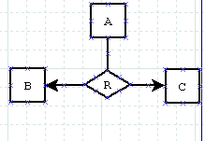
Cardinality Constraints on Ternary Relationship
If there is more than one arrow, there are two ways of defining the meaning.
E.g a ternary relationship R between A, B and C with arrows to B and C could mean
1. each A entity is associated with a unique entity from B and C or
2. each pair of entities from (A, B) is associated with a unique C entity, and each pair (A, C) is associated with a unique B
Each alternative has been used in different formalisms
To avoid confusion we outlaw more than one arrow

Slide 5
Design Issues
Use of entity sets vs. attributes Choice mainly depends on the structure of the enterprise being modeled, and on the semantics associated with the attribute in question.
Binary versus n-ary relationship sets Although it is possible to replace any nonbinary (n-ary, for n > 2) relationship set by a number of distinct binary relationship sets, a n-ary relationship set shows more clearly that several entities participate in a single relationship.
Placement of relationship attributes

Slide 6
Binary Vs. Non-Binary Relationships
Some relationships that appear to be non-binary may be better represented using binary relationships
E.g. A ternary relationship parents, relating a child to his/her father and mother, is best replaced by two binary relationships, father and mother
Using two binary relationships allows partial information (e.g. only mother being known)
But there are some relationships that are naturally non-binary
Example: works_on

Slide 7
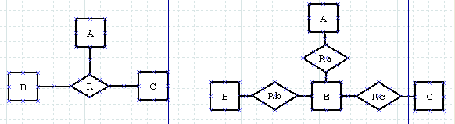
Converting Non-Binary Relationships to Binary Form
In general, any non-binary relationship can be represented using binary relationships by creating an artificial entity set.
Replace R between entity sets A, B and C by an entity set E, and three relationship sets:
1. R_{a}, relating E and A 2.R_{b}, relating E and B
3. R_{c}, relating E and C
Create a special identifying attribute for E
Add any attributes of R to E
For each relationship (a_{i} , b_{i} , c_{i}) in R, create
1. a new entity e_{i} in the entity set E 2. add (e_{i} , a_{i} ) to R_{a}
3. add (e_{i} , b_{i} ) to R_{b} 4. add (e_{i} , c_{i} ) to R_{c}

Slide 8
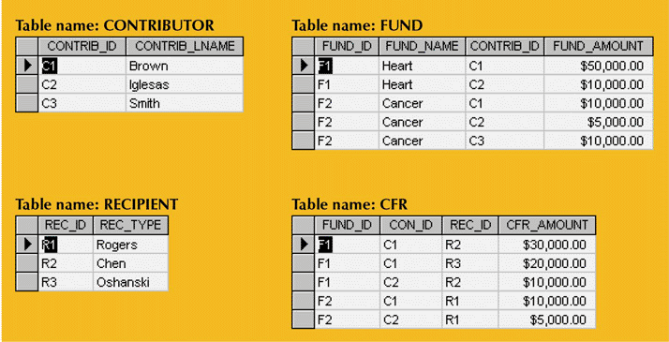
Implementation of a Ternary Relationship

